Slide 1
Graphs

Slide 2
Graphs
Graph of the internet (circa 1999…it’s a lot bigger now…)

Slide 3
Graphs
Citation graph of literary theory academic papers

Slide 4
Graphs
Theoretical Computer Science academic communities

Slide 5
Graphs
jetblue flights

Slide 6
Graphs
Potato trade

Slide 7
Graphs
Neural connections in the brain

Slide 8
Graphs
There are a lot of graphs.
We want to answer questions about them.
Efficient routing?
Community detection/clustering?
An ordering that respects dependencies?
This is what we’ll do for the next several lectures.

Slide 9
Undirected Graphs
2
1
Has vertices and edges
V is the set of vertices
E is the set of edges
Formally, a graph is G = (V,E)
Example
V = {1,2,3,4}
E = { {1,3}, {2,4}, {3,4}, {2,3} }
3
G = (V,E)
4
The degree of vertex 4 is 2.
There are 2 edges coming out.
Vertex 4’s neighbors are 2 and 3

Slide 10
Directed Graphs
2
1
Has vertices and edges
V is the set of vertices
E is the set of DIRECTED edges
Formally, a graph is G = (V,E)
Example
V = {1,2,3,4}
E = { (1,3), (2,4), (3,4), (4,3), (3,2) }
3
G = (V,E)
4
The in-degree of vertex 4 is 2.
The out-degree of vertex 4 is 1.
Vertex 4’s incoming neighbors are 2
Vertex 4’s outgoing neighbor is 3.

Slide 11
Graph Representation

Slide 12
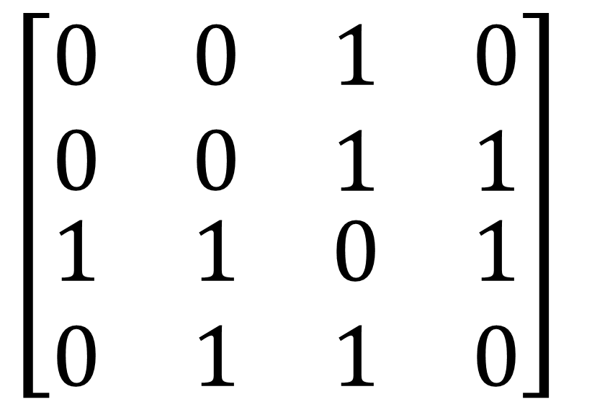
How do we represent graphs?
Option 1: adjacency matrix
Indegree?
2
Outdegree?
1 2 3 4
1
$$\left[\begin{matrix}\begin{matrix}0 & 0 \\ 0 & 0\end{matrix} & \begin{matrix}1 & 0 \\ 1 & 1\end{matrix} \\ \begin{matrix}1 & 1 \\ 0 & 1\end{matrix} & \begin{matrix}0 & 1 \\ 1 & 0\end{matrix}\end{matrix}\right]$$
3
4
1 2 3 4

Slide 13
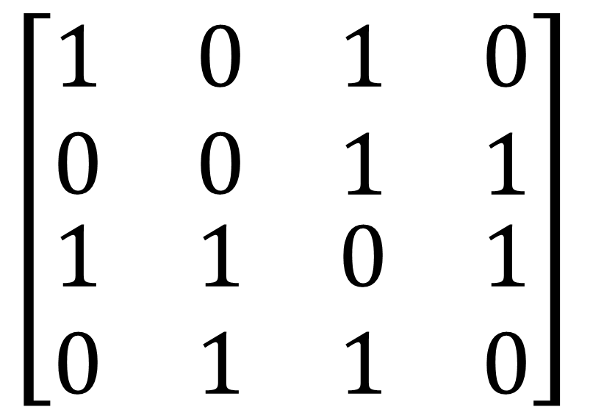
How do we represent graphs?
Option 1: adjacency matrix
2
1 2 3 4
1
$$\left[\begin{matrix}\begin{matrix}1 & 0 \\ 0 & 0\end{matrix} & \begin{matrix}1 & 0 \\ 1 & 1\end{matrix} \\ \begin{matrix}1 & 1 \\ 0 & 1\end{matrix} & \begin{matrix}0 & 1 \\ 1 & 0\end{matrix}\end{matrix}\right]$$
3
4
1 2 3 4

Slide 14
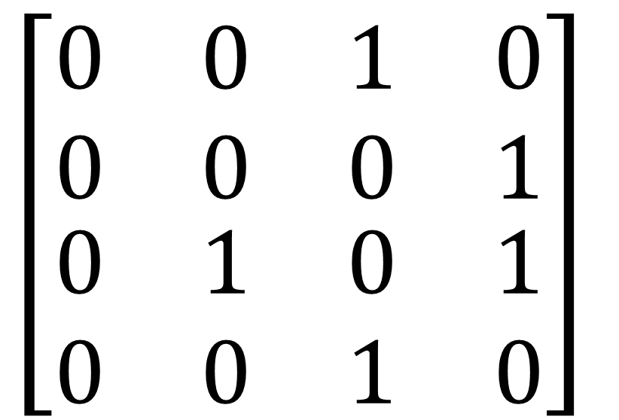
How do we represent graphs?
2
Option 1: adjacency matrix
Destination
1 2 3 4
1
$$\left[\begin{matrix}\begin{matrix}0 & 0 \\ 0 & 0\end{matrix} & \begin{matrix}1 & 0 \\ 0 & 1\end{matrix} \\ \begin{matrix}0 & 1 \\ 0 & 0\end{matrix} & \begin{matrix}0 & 1 \\ 1 & 0\end{matrix}\end{matrix}\right]$$
3
4
1 2 3 4
Source

Slide 15
How do we represent graphs?
Option 2: linked lists.
2
1
2
3
4
1
3
3
4
1
2
4
4
3
3
How would you modify this for directed graphs?
2
4’s neighbors are 2 and 3

Slide 16
In either case
May think of vertices storing other information
Attributes (name, IP address, …)
helper info for algorithms that we will perform on the graph
We will want to be able to do the following ops:
Edge Membership: Is edge e in E?
Neighbor Query: What are the neighbors of vertex v?

Slide 17
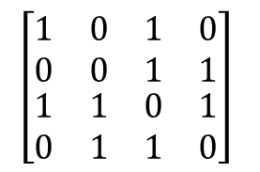
Trade-offs
Generally better for sparse graphs
1
2
3
4
Say there are n vertices and m edges.
$$\left[\begin{matrix}\begin{matrix}1 & 0 \\ 0 & 0\end{matrix} & \begin{matrix}1 & 0 \\ 1 & 1\end{matrix} \\ \begin{matrix}1 & 1 \\ 0 & 1\end{matrix} & \begin{matrix}0 & 1 \\ 1 & 0\end{matrix}\end{matrix}\right]$$
3
4
1
2
3
4
3
Edge membership
Is e = {v,w} in E?
O(1)
O(deg(v)) or O(deg(w))
Neighbor query
Give me v’s neighbors.
O(n)
O(deg(v))
Space requirements
O(n²)
O(n + m)
We’ll assume this representation for the rest of the class

Slide 18
Assignment Question 1
Design a Graph Class with following functions
EdgeMemberShip
NeighbourQuery
Add Edge
Constructor(List of Vertices)

Slide 19
Depth-first search

Slide 20
How do we explore a graph?
At each node, you can get a list of neighbors, and choose to go there if you want.
6
5
7
2
8
1
3
4
Notes:
This is how Theseus did it.

Slide 21
Depth First Search Exploring a labyrinth with chalk and a piece of string
Not been there yet
Been there, haven’t explored all the paths out.
Been there, have explored all the paths out.
start

Slide 22
Depth First Search Exploring a labyrinth with chalk and a piece of string
Not been there yet
Been there, haven’t explored all the paths out.
Been there, have explored all the paths out.
start

Slide 23
Depth First Search Exploring a labyrinth with chalk and a piece of string
Not been there yet
Been there, haven’t explored all the paths out.
Been there, have explored all the paths out.
start

Slide 24
Depth First Search Exploring a labyrinth with chalk and a piece of string
Not been there yet
Been there, haven’t explored all the paths out.
Been there, have explored all the paths out.
start

Slide 25
Depth First Search Exploring a labyrinth with chalk and a piece of string
Not been there yet
Been there, haven’t explored all the paths out.
Been there, have explored all the paths out.
start

Slide 26
Depth First Search Exploring a labyrinth with chalk and a piece of string
Not been there yet
Been there, haven’t explored all the paths out.
Been there, have explored all the paths out.
start

Slide 27
Depth First Search Exploring a labyrinth with chalk and a piece of string
Not been there yet
Been there, haven’t explored all the paths out.
Been there, have explored all the paths out.
start

Slide 28
Depth First Search Exploring a labyrinth with chalk and a piece of string
Not been there yet
Been there, haven’t explored all the paths out.
Been there, have explored all the paths out.
start

Slide 29
Depth First Search Exploring a labyrinth with chalk and a piece of string
Not been there yet
Been there, haven’t explored all the paths out.
Been there, have explored all the paths out.
start

Slide 30
Depth First Search Exploring a labyrinth with chalk and a piece of string
Not been there yet
Been there, haven’t explored all the paths out.
Been there, have explored all the paths out.
start

Slide 31
Depth First Search Exploring a labyrinth with chalk and a piece of string
Not been there yet
Been there, haven’t explored all the paths out.
Been there, have explored all the paths out.
start

Slide 32
Depth First Search Exploring a labyrinth with chalk and a piece of string
Not been there yet
Been there, haven’t explored all the paths out.
Been there, have explored all the paths out.
start

Slide 33
Depth First Search Exploring a labyrinth with chalk and a piece of string
Not been there yet
Been there, haven’t explored all the paths out.
Been there, have explored all the paths out.
start

Slide 34
Depth First Search Exploring a labyrinth with chalk and a piece of string
Not been there yet
Been there, haven’t explored all the paths out.
Been there, have explored all the paths out.
start

Slide 35
Depth First Search Exploring a labyrinth with chalk and a piece of string
Not been there yet
Been there, haven’t explored all the paths out.
Been there, have explored all the paths out.
start

Slide 36
Depth First Search Exploring a labyrinth with chalk and a piece of string
Not been there yet
Been there, haven’t explored all the paths out.
Been there, have explored all the paths out.
start
Labyrinth:
explored!

Slide 37
Depth First Search Exploring a labyrinth with pseudocode
Each node is going to keep track of whether it’s unvisited, in progress, or all done.
We’ll also keep track of the time at which we started and finished with that node.
DFS(w, currentTime):
w.entryTime = currentTime
currentTime ++
Mark w as in progress.
for v in w.neighbors:
if v is unvisited:
currentTime = DFS(v, currentTime)
currentTime ++
w.finishTime = currentTime
Mark w as all done
return currentTime
Plucky the pedantic penguin

Slide 38
Depth First Search Exploring a labyrinth with pseudocode
Each vertex keeps track of whether it is:
Unvisited
In progress
All done
Each vertex will also keep track of:
The time we first enter it.
The time we finish with it and mark it all done.
You might have seen other ways to implement DFS than what we are about to go through. This way has more bookkeeping, but more intuition – also, the bookkeeping will be useful later!

Slide 39
Depth First Search
currentTime = 0
DFS(w, currentTime):
w.entryTime = currentTime
currentTime ++
Mark w as in progress.
for v in w.neighbors:
if v is unvisited:
currentTime
= DFS(v, currentTime)
currentTime ++
w.finishTime = currentTime
Mark w as all done
return currentTime
D
A
w
C
unvisited
in progress
all done

Slide 40
Depth First Search
currentTime = 1
DFS(w, currentTime):
w.entryTime = currentTime
currentTime ++
Mark w as in progress.
for v in w.neighbors:
if v is unvisited:
currentTime
= DFS(v, currentTime)
currentTime ++
w.finishTime = currentTime
Mark w as all done
return currentTime
D
A
w
Start:0
C
unvisited
in progress
all done

Slide 41
Depth First Search
currentTime = 1
DFS(w, currentTime):
w.entryTime = currentTime
currentTime ++
Mark w as in progress.
for v in w.neighbors:
if v is unvisited:
currentTime
= DFS(v, currentTime)
currentTime ++
w.finishTime = currentTime
Mark w as all done
return currentTime
D
A
Start:0
C
w
unvisited
in progress
all done

Slide 42
Depth First Search
currentTime = 2
DFS(w, currentTime):
w.entryTime = currentTime
currentTime ++
Mark w as in progress.
for v in w.neighbors:
if v is unvisited:
currentTime
= DFS(v, currentTime)
currentTime ++
w.finishTime = currentTime
Mark w as all done
return currentTime
D
A
Start:0
C
w
Start: 1
unvisited
in progress
all done

Slide 43
Depth First Search
0
DFS(w, currentTime):
w.entryTime = currentTime
currentTime ++
Mark w as in progress.
for v in w.neighbors:
if v is unvisited:
currentTime
= DFS(v, currentTime)
currentTime ++
w.finishTime = currentTime
Mark w as all done
return currentTime
currentTime = 2
D
A
Start:0
C
Start: 1
unvisited
in progress
Takes until currentTIme = 20
all done

Slide 44
Depth First Search
currentTime = 21
DFS(w, currentTime):
w.startTime = currentTime
currentTime ++
Mark w as in progress.
for v in w.neighbors:
if v is unvisited:
currentTime
= DFS(v, currentTime)
currentTime ++
w.finishTime = currentTime
Mark w as all done
return currentTime
D
A
Start:0
C
w
Start: 1
End: 21
unvisited
in progress
Takes until currentTIme = 20
all done

Slide 45
Depth First Search
currentTime = 21
DFS(w, currentTime):
w.startTime = currentTime
currentTime ++
Mark w as in progress.
for v in w.neighbors:
if v is unvisited:
currentTime
= DFS(v, currentTime)
currentTime ++
w.finishTime = currentTime
Mark w as all done
return currentTime
etc
D
w
A
Start:0
C
Start: 1
End: 21
unvisited
in progress
Takes until currentTIme = 20
all done

Slide 46
DFS finds all the nodes reachable from the starting point
In an undirected graph, this is called a connected component.
start
One application: finding connected components.

Slide 47
Why is it called depth-first?
We are implicitly building a tree:
And first we go as deep as we can.
YOINK!
D
E
A
F
B
A
E
C
B
Call this the “DFS tree”
G
G
C
F
D

Slide 48
Running time To explore just the connected component we started in
We look at each edge only once.
And basically don’t do anything else.
So…
O(m)
(Assuming we are using the linked-list representation)
Verify this formally!
Ollie the over-achieving ostrich

Slide 49
Running time To explore the whole thing
Explore the connected components one-by-one.
This takes time
O(n + m)
or

Slide 50
Applications of DFS

Slide 51
topological sorting: Application of DFS
Example: package dependency graph
Question: in what order should I install packages?
coreutils
multiarch-support
tar
dpkg
libselinux1
libbz2
Suppose the dependency graph has no cycles:
it is a Directed Acyclic Graph (DAG)

Slide 52
Let’s do DFS
Observations:
The start times don’t seem that useful.
But the packages we should include earlier have larger finish times.
start:9
finish:10
coreutils
start:7
finish:8
multiarch-support
tar
start:3
finish:4
dpkg
start:0
finish:11
libselinux1
libbz2
start:2
start:1
finish:5
finish:6

Slide 53
This is not an accident
Suppose the underlying graph has no cycles
Claim: In general, we’ll always have:
A
B
finish: [larger]
finish: [smaller]
To understand why, let’s go back to that DFS tree.

Slide 54
A more general statement (this holds even if there are cycles) This is called the “parentheses theorem” in CLRS
(check this statement carefully!)
If v is a descendent of w in this tree:
If w is a descendent of v in this tree:
If neither are descendents of each other:
w.start
v.start
v.finish
w.finish
timeline
w
w
v.start
w.start
w.finish
v.finish
v.start
v.finish
w.start
w.finish
v
v
(or the other way around)

Slide 55
So to prove this ->
A
B
If
Then B.finishTime < A.finishTime
Suppose the underlying graph has no cycles
Since the graph has no cycles, B must be a descendent of A in that tree.
All edges go down the tree.
Then
aka, B.finishTime < A.finishTime.
B.startTime
A.finishTime
A.startTime
B.finishTime

Slide 56
Back to this problem
Example: package dependency graph
Question: in what order should I install packages?
coreutils
multiarch-support
tar
dpkg
libselinux1
libbz2

Slide 57
In reverse order of finishing time
Do DFS
Maintain a list of packages, in the order you want to install them.
When you mark a vertex as all done, put it at the beginning of the list.
dpkg
coreutils
tar
libbz2
libselinux1
multiarch_support
start:9
coreutils
finish:10
start:3
start:7
finish:8
multiarch-support
tar
finish:4
dpkg
start:0
finish:11
libselinux1
libbz2
start:2
start:1
finish:6
finish:5

Slide 58
What did we just learn?
DFS can help you solve the topological sorting problem
That’s the fancy name for the problem of finding an ordering that respects all the dependencies
Thinking about the DFS tree is helpful.

Slide 59
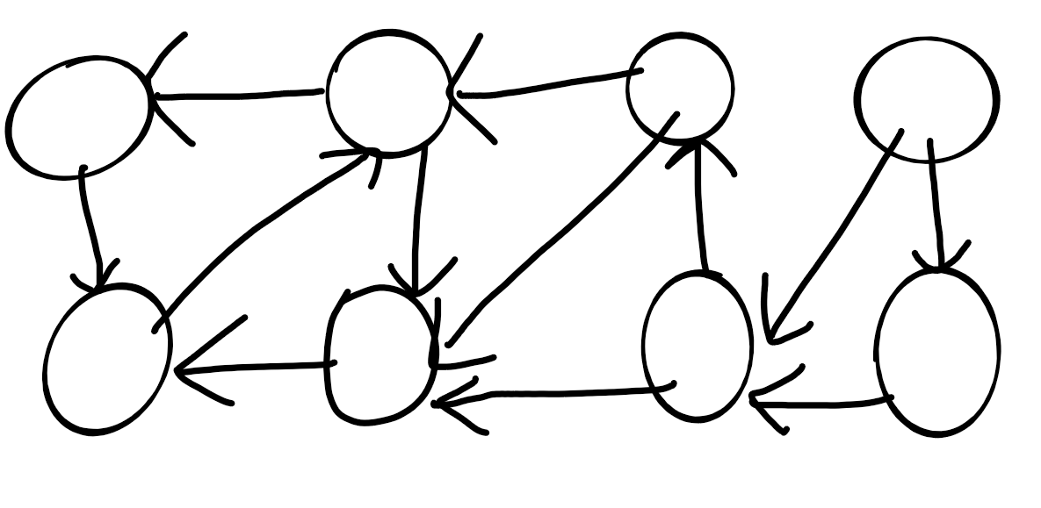
Classification of Edges
Tree Edge
Back Edge
Forward Edge
Cross Edge

Slide 60
Breadth-First Search

Slide 61
How do we explore a graph?
If we can fly
5
4
1
3
7
8
6
2
9

Slide 62
Breadth-First Search Exploring the world with a bird’s-eye view
Not been there yet
Can reach there in zero steps
Can reach there in one step
start
Can reach there in two steps
Can reach there in three steps

Slide 63
Breadth-First Search Exploring the world with a bird’s-eye view
Not been there yet
Can reach there in zero steps
Can reach there in one step
start
Can reach there in two steps
Can reach there in three steps

Slide 64
Breadth-First Search Exploring the world with a bird’s-eye view
Not been there yet
Can reach there in zero steps
Can reach there in one step
start
Can reach there in two steps
Can reach there in three steps

Slide 65
Breadth-First Search Exploring the world with a bird’s-eye view
Not been there yet
Can reach there in zero steps
Can reach there in one step
start
Can reach there in two steps
Can reach there in three steps

Slide 66
Breadth-First Search Exploring the world with a bird’s-eye view
Not been there yet
Can reach there in zero steps
Can reach there in one step
start
Can reach there in two steps
Can reach there in three steps
World:
explored!

Slide 67
Breadth-First Search Exploring the world with pseudocode
Same disclaimer as for DFS: you may have seen other ways to implement this, this will be convenient for us.
L_{i} is the set of nodes we can reach in i steps from w
Set L_{i} = {} for i=1,…,n
L₀ = {w}, where w is the start node
For i = 0, …, n-1:
For u in L_{i}:
For each v which is a neighbor of u:
If v isn’t yet visited:
mark v as visited, and put it in L_{i+1}
-
L₀
L₁
Go through all the nodes in L_{i} and add their unvisited neighbors to L_{i+1}
L₂
L₃

Slide 68
BFS also finds all the nodes reachable from the starting point
start
It is also a good way to find all the connected components.

Slide 69
Running time To explore the whole thing
Explore the connected components one-by-one.
Same argument as DFS: running time is
O(n + m)
Like DFS, BFS also works fine on directed graphs.
Verify these!
Ollie the over-achieving ostrich

Slide 70
Why is it called breadth-first?
We are implicitly building a tree:
And first we go as broadly as we can.
YOINK!
D
L₀
E
A
F
L₁
B
A
E
L₂
F
B
C
D
G
L₃
C
G
Call this the “BFS tree”
Notes:
This tree has some really nice structure: all the things at the first level are one away from the root, all the things at the second level are two away from the root, and so on.

Slide 71
Applications of BFS

Slide 72
Application: shortest path
How long is the shortest path between w and v?
w
v

Slide 73
Application: shortest path
How long is the shortest path between w and v?
Not been there yet
Can reach there in zero steps
w
Can reach there in one step
Can reach there in two steps
v
Can reach there in three steps
It’s three!

Slide 74
To find the distance between w and all other vertices v
The distance between two vertices is the length of the shortest path between them.
Do a BFS starting at w
For all v in L_{i} (the i’th level of the BFS tree)
The shortest path between w and v has length i
A shortest path between w and v is given by the path in the BFS tree.
If we never found v, the distance is infinite.

Slide 75
What did we just learn?
The BFS tree is useful for computing distances between pairs of vertices.
We can find the shortest path between u and v in time O(m).
The BSF tree is also helpful for:
Testing if a graph is bipartite or not.

Slide 76
Application: testing if a graph is bipartite
Bipartite means it looks like this:
Can color the vertices red and orange so that there are no edges between any same-colored vertices
Example:
are students
are classes
if the student is enrolled in the class

Slide 77
Is this graph bipartite?

Slide 78
How about this one?

Slide 79
How about this one?

Slide 80
Solution using BFS
Color the levels of the BFS tree in alternating colors.
If you ever color a node so that you never color two connected nodes the same, then it is bipartite.
Otherwise, it’s not.
A
B
E
F
C
D
G

Slide 81
Breadth-First Search For testing bipartite-ness
Not been there yet
Can reach there in zero steps
Can reach there in one step
start
Can reach there in two steps
Can reach there in three steps

Slide 82
Breadth-First Search For testing bipartite-ness
Not been there yet
Can reach there in zero steps
Can reach there in one step
start
Can reach there in two steps
Can reach there in three steps

Slide 83
Breadth-First Search For testing bipartite-ness
Not been there yet
Can reach there in zero steps
Can reach there in one step
start
Can reach there in two steps
Can reach there in three steps

Slide 84
Breadth-First Search For testing bipartite-ness
Not been there yet
Can reach there in zero steps
Can reach there in one step
start
Can reach there in two steps
Can reach there in three steps

Slide 85
Breadth-First Search For testing bipartite-ness
Not been there yet
Can reach there in zero steps
Can reach there in one step
start
Can reach there in two steps
Can reach there in three steps
CLEARLY BIPARTITE!

Slide 86
Breadth-First Search For testing bipartite-ness
Not been there yet
Can reach there in zero steps
Can reach there in one step
start
Can reach there in two steps
Can reach there in three steps

Slide 87
Breadth-First Search For testing bipartite-ness
Not been there yet
Can reach there in zero steps
Can reach there in one step
start
Can reach there in two steps
Can reach there in three steps

Slide 88
Breadth-First Search For testing bipartite-ness
Not been there yet
Can reach there in zero steps
Can reach there in one step
start
Can reach there in two steps
Can reach there in three steps

Slide 89
Breadth-First Search For testing bipartite-ness
Not been there yet
Can reach there in zero steps
Can reach there in one step
start
Can reach there in two steps
Can reach there in three steps

Slide 90
Breadth-First Search For testing bipartite-ness
Not been there yet
Can reach there in zero steps
Can reach there in one step
start
Can reach there in two steps
WHOA NOT BIPARTITE!
Can reach there in three steps

Slide 91
What did we just learn?
BFS can be used to detect bipartite-ness in time O(n + m).

Slide 92
Consider a hash table of size m = 1000 and a corresponding hash function h(k) = ⌊m (kA mod 1)⌋ for . Compute the locations to which the keys 61, 62, 63, 64, and 65 are mapped. A is equal to 0.618033

